Slide 1
Finalizing Our Recommended Public Health Guidelines for Social Connection

Slide 2
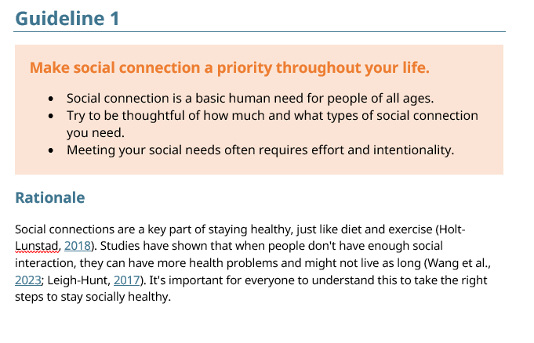
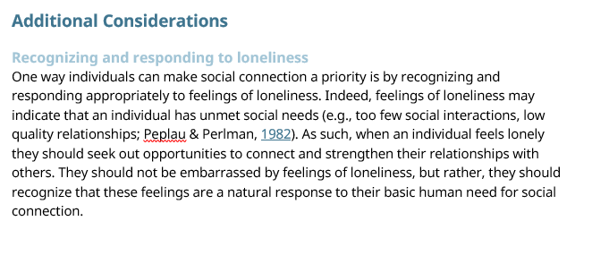
Options for Addressing Feedback from Round Three
Feedback can be addressed through:
Revising Guidelines & Sub guidelines
Rationale / Supporting evidence
Additional Considerations

Slide 3
Pass Criteria
80%
Among Raters
Among Participants
Among Experts with “High” Self-Rated Domain Knowledge
N = 82
75%
Number of Experts Participating in Round Three
85%

Slide 4
Among raters
Among all participants
Among experts with “high” self-rated domain expertise
97.5%
/ 80%
96.3%
/ 75%
98.1%
/ 85%
Guideline 1: Make social connection a priority throughout your life. Social connection is a basic human need for people of all ages. Try to be thoughtful of how much and what types of social connection you need. Meeting your social needs often requires effort and intentionality.
Key Potential Revisions Social connection is not a luxury, emphasize its fundamental importance including for survival and biological function. “How much” and “what types” are vague. Unpack these to add specificity or clarify this point to explain individual variations in need. People may require support to meet their social needs and we can assist them by providing that support. Make social connection a priority in all areas of your life Considerations regarding alone time and solitude. Considerations regarding ambiguous / harmful relationships. Social needs or social connection needs?
Notes:
Additional Considerations for this Guideline
Recognizing and responding to loneliness
Individual differences in sociability
The importance of proactive and intentional efforts
Avoiding Social Overload

Slide 5
Among raters
Among all participants
Among experts with “high” self-rated domain expertise
83.8%
/ 80%
77.5%
/ 75%
86.7%
/ 85%
Guideline 2: Cultivate a positive social outlook and sense of self. Many individuals experience thoughts and feelings that stop them from engaging with others, including fear of rejection, social anxiety, self-doubt, and comparison to others. Try to counter these thoughts and feelings by practicing strategies such as (a) fostering self-compassion, (b) grounding your beliefs in objective facts, (c) experimenting with taking gradual steps outside your comfort zone, and (d) trying to assume the best with respect to how others feel about you. Additionally, rather than thinking of time spent alone as a negative reflection on you or your social life, try to value this time an opportunity for solitude, a time to recharge, and a chance to meet your personal wellness needs. If you find it difficult to overcome your thoughts and feelings, seek support from others, including trained mental health professionals who can help you reach your social health goals.
Key Potential Revisions Acknowledge that it is okay to feel lonely, socially anxious, uneasy, etc. Explain that individuals are not to blame but that society creates these feelings. Endorse acceptance of unwanted thoughts and feeling. Clarify meaning or remove scientific terms (e.g., Sense of self) Acknowledge racism, bullying, harassment, and violence as reasons people might avoid socializing. Don’t recommend blind trust (or assumptions of best in others) Acknowledge that access to mental health supports is patchwork.
Emphasize individuals need to start small, as these can be difficult changes to make. Encourage empathy for others (e.g., social anxiety) Provide guidance on how to do build capacities. Describe the importance of solitude. Discourage inward attentional focus, encourage thinking outwardly. Explain that individuals tend to underestimate how much they will enjoy socializing and tend to overestimate the threats of socializing.
Notes:
Additional Considerations for this Guideline
Starting small and scaffolding your social development
Turning to others for support
Cultivating Capacity for Solitude
Managing Existential Isolation and Loneliness
Coping with Loneliness

Slide 6
Among raters
Among all participants
Among experts with “high” self-rated domain expertise
96.0%
/ 80%
93.5%
/ 75%
97.8%
/ 85%
Guideline 3: Build a strong social network. Strive to develop a close circle of several trusted friends and family, rather than relying on just one person to meet all your social needs. Work to have positive and meaningful connections in all areas of your life, including at work, school, home, and in your neighbourhood communities.
Key Potential Revisions Strong and diverse Add in collective identity as an important part of social network Is all domains necessary, or just sometimes beneficial? Do we risk making people deficient? (Various areas vs. all areas) Tips on how to implement guidelines Framing guidelines as speaking to individuals or describing the support individuals need (who are these talking to) Address quality of connections
Notes:
Additional Considerations for this Guideline
The typical size of a social network
Challenges of a large social network
Different benefits of different types of social relationships
The harm of ambivalent relationships
Resilient social networks
Developing a Sense of Belonging

Slide 7
Among raters
Among all participants
Among experts with “high” self-rated domain expertise
88.9%
/ 80%
92.1%
/ 75%
90.2%
/ 85%
Guideline 4: Get enough social connection, but invest your social energy where it counts. Individuals need regular and frequent social interaction. Strive for near-daily social interactions, even if brief. Spend at least a few hours every week socializing with your close friends and family. Prioritize close, rewarding relationships, but don't neglect social interaction with acquaintances or even strangers.
Key Potential Revisions Explain the concepts of ambiguous and harmful relationships. Define or avoid non-specific quantities (e.g., a few hours) Acknowledge that some may not have close friends or family. Encourage individuals to engage in diverse social interactions (i.e., spend time with diverse others). Strengthen language supporting the value of weak ties, casual collisions, etc. Don’t pit different types of relationships against eachother (i.e., “Prioritize X”) Avoid Normative assumptions about people’s social situation or preferences. Clarify or exclude the “social energy” concept.
Notes:
Additional Considerations for this Guideline
Typical levels of social interaction
The quality of time spent with others
The importance of social interaction and prosocial behaviour

Slide 8
Among raters
Among all participants
Among experts with “high” self-rated domain expertise
95.8%
/ 80%
88.5%
/ 75%
97.6%
/ 85%
Guideline 5: Develop new relationships and deepen the ones you have. Take initiative to improve your social life and the social life of those in your communities. Be open to new connections and build the skills and strategies needed to make new friends. Try to strengthen your relationships by fostering reciprocity, openness, and trust with others. Learn and practice the social skills needed to navigate social challenges, including good communication, compassion, and boundary-setting to maintain healthy relationships.
Key Potential Revisions Reframe this guideline to focus on social skills, as this aligns more strongly with the previous two guidelines. Provide resources for developing these skills. Mention the benefits of routines and rituals; being proactive and taking the initiative. Split this into two guidelines: one about starting relationships, the other about deepening them.
Notes:
Additional Considerations for this Guideline
Being a connector
Celebrating and sharing our culture
Meeting New People and Making New Friends
Deepening Relationships
Overcoming Social Challenges

Slide 9
Among raters
Among all participants
Among experts with “high” self-rated domain expertise
88.2%
/ 80%
78.9%
/ 75%
86.2%
/ 85%
Guideline 6: Use technology as a tool for social connection. Seek out and prioritize opportunities for face-to-face, in-person social interactions with others. Actively use technologies and platforms that benefit and strengthen your relationships with others, such as those that help you organize social activities or interact meaningfully with others while you are apart. Limit passive use of social media and other technologies when they distract from social interactions, monopolize your time and attention, or negatively impact how you feel about yourself of others.
Key Potential Revisions Acknowledge sometimes technology is the preferred or necessary option (e.g., safety, technology & accessibility) Don’t pit face to face technology against in person technology (i.e., Prioritize X) Define passive and active use Consider stronger title, since most guidelines talk about limiting or carefully using rather than embracing.
Notes:
Additional Considerations for this Guideline
Understanding the difference between active and passive social media use
Remote, Hybrid, and In-person Work

Slide 10
Among raters
Among all participants
Among experts with “high” self-rated domain expertise
98.6%
/ 80%
92.2%
/ 75%
97.2%
/ 85%
Guideline 7: Promote awareness of the importance of social connection. Play an active role in promoting widespread awareness of the importance of social connection.
Key Potential Revisions Provide examples of awareness activities. Identify what “communities” should be doing this.
Notes:
Additional Considerations for this Guideline
Methods of promoting social connection
Addressing stigma

Slide 11
Among raters
Among all participants
Among experts with “high” self-rated domain expertise
94.4%
/ 80%
87.2%
/ 75%
92.0%
/ 85%
Guideline 8: Foster healthy social and emotional development Develop and implement age and community-appropriate social and emotional education activities, curriculum, resources, and other tailored supports to support the development of social health.
Key Potential Revisions Emphasize the relevance to all age groups. Promote age-specific, intergenerational, and age-friendly activities. Explain that this is contingent on providing adequate resourcing for communities.
Notes:
Additional Considerations for this Guideline
Age-Appropriate Educational Curricula

Slide 12
Among raters
Among all participants
Among experts with “high” self-rated domain expertise
98.6%
/ 80%
90.1%
/ 75%
100.0%
/ 85%
Guideline 9: Make social health a priority in all policies and practices Make social connection a top public health and policy priority. Consider the social health impacts of policy decisions and review existing policies to assess how they can foster social connection. Make substantial investments in social health programming and organizations that support social connection.
Key Potential Revisions Highlight the importance of identifying and breaking down existing barriers. Emphasize relevance to all sectors/organization levels. Clarify all “relevant” policies” Remove “all” Say “prioritize the social health impacts…” rather than “consider…”
Notes:
Additional Considerations for this Guideline
Enhanced and targeted funding
Healthy Workplace Policies
Leveraging and integrating existing resources
Structural interventions to promote social health

Slide 13
Among raters
Among all participants
Among experts with “high” self-rated domain expertise
97.3%
/ 80%
91.0%
/ 75%
96.6%
/ 85%
Guideline 10: Build communities for connection and invest in social health programming Ensure that the built and natural environment is suitable for encouraging, facilitating, and sustaining social connections. Implement programming that maximizes social use of the built and natural environment thereby providing opportunities for social connection and interaction within communities.
Suggested Revisions Identify specific features (e.g., transportation systems, social infrastructure). Provide concrete suggestions for how to do this.
Notes:
Additional Considerations for this Guideline
Community and Civic Development
Buildings
Outdoor Spaces
Transportation
Civic Engagement and Volunteerism
Collaborative Education and After-School Programs
Cultural Diversity and Inclusion
Adaptive Community Programming
Intergenerational and Age-Appropriate Activities
Seasonal and Diverse Events
Public Dialogue and Resource Accessibility

Slide 14
Among raters
Among all participants
Among experts with “high” self-rated domain expertise
100.0%
/ 80%
97.4%
/ 75%
100.0%
/ 85%
Guideline 11: Improve accessibility and inclusion for all people. Ensure that all spaces and activities are equitably accessible for all community members. Ensure that tailored activities and programs are available for people of different ages, abilities, socioeconomic classes, cultural backgrounds, and with different social and recreational interests. Actively seek to eliminate stigma, discrimination, and violence against marginalized communities.
Key Potential Revisions Provide concrete examples. Remove any potentially stigmatizing langue (e.g, marginalized, classes)
Notes:
Additional Considerations for this Guideline
Acknowledge and remediate barriers to social inclusion
Accommodating diverse lifestyles and interests
Addressing Stigma, Discrimination and Violence

Slide 15
Among raters
Among all participants
Among experts with “high” self-rated domain expertise
94.4%
/ 80%
87.2%
/ 75%
96.8%
/ 85%
Guideline 12: Measure progress towards improving social health. Develop measurement frameworks for understanding the social well-being of your community. Measure the social health of your community and monitor progress towards improvements in social health. Identify the best, evidence-based strategies for promoting social health. Prioritizing strategies that reduce disparities in the social health of equity-seeking communities.
Key Potential Revisions Emphasize the importance of identifying effective interventions. Provide guidelines for conducting measurement. Emphasis the importance of funding research.
Notes:
Additional Considerations for this Guideline
Monitoring
Research and Evaluation
Equity

Slide 16
General Comments & What’s Missing?
No identified gaps or missing guidelines
Comments generally limited, but a few concerns identified by individuals:
Description of the biology of social connection (i.e., homeostasis model)
Good guidelines, but potentially difficult to accomplish.
More specificity to support implementation and execution of guidelines.
Tailoring is good for individuals, but less so for care providers/givers.
Guidelines focus on prevention, but what about those experiencing loneliness.
Important to note that communities can support individuals and individuals can support communities in execution of guidelines.
Concerns about language and tone (e.g., “woke-ness”)

Slide 17
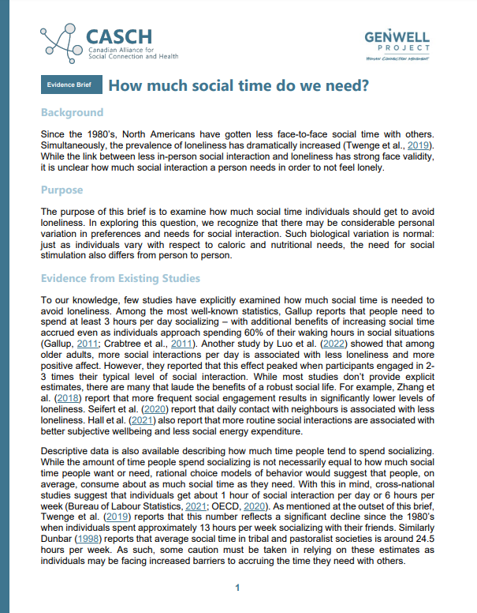
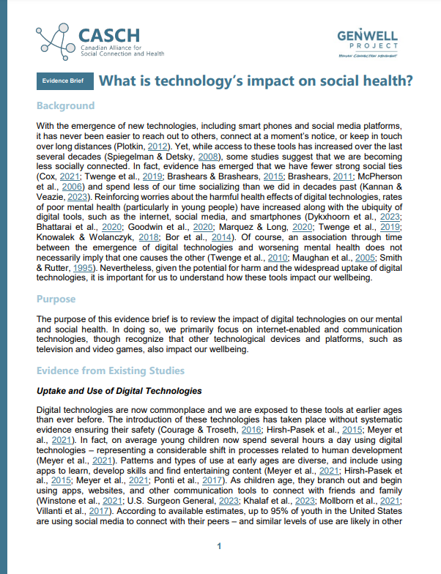
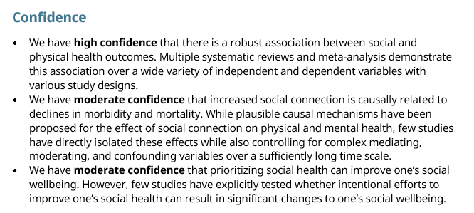
Future Delphi Study Activities
Key Populations Focus groups
To identify any red flags and additional considerations.
Focus Group and Key Informant Interviews
To discuss potential changes and finalize wording/
Fourth Round of Delphi Study
Present finalized guidelines (individually or as a whole)
Assess support
Assess Confidence (e.g., rate likelihood of additional information resulting in revocation of guideline)
Managing Attrition (Numbers declining as of last ~90 to ~80).

Slide 18
Thank you!
Email kcard@sfu.ca for any follow-up.

